Slide 1
Secure Multi-Site Enterprise Network for Anatolia Logistics
YBS417 · NETWORK MANAGEMENT AND SECURITY
Design, subnetting, configuration, security and traffic analysis in Cisco Packet Tracer 9.0
[Name 1] · [Name 2] · [Name 3]
Piri Reis University · MIS Department
192.168.10.0/24
Notes:
Good morning. We are presenting our Network Management and Security project. We designed the network of a fictional logistics company, Anatolia Logistics, with a headquarters, a branch office and an Internet connection. We built everything in Cisco Packet Tracer 9.0. In about ten minutes we will show the design, the subnetting, the configuration, the security controls and our test results.

Slide 2
One company, two sites, one /24 block
01 · THE SCENARIO
Anatolia Logistics has a Headquarters with five departments, a small Branch Office and an Internet uplink. It needs separated departments, automatic addressing, central management and protection from guests and LAN attacks.
Segment
Size right
Manage
Secure
Six VLANs, one per department and site
VLSM: every subnet fits its real host count
DHCP, Syslog, NTP, TFTP backups, SSH
Controls at device, port, VLAN, routing and traffic layers
2 / 14
Notes:
The company has a headquarters with IT, HR, Sales, Guest and Server segments, plus a branch office. We were given only one private block, 192.168.10.0/24. Our four design goals were: segment the network, size every subnet correctly with VLSM, make it easy to manage centrally, and secure it in several layers. Everything we show later maps back to one of these four goals.

Slide 3
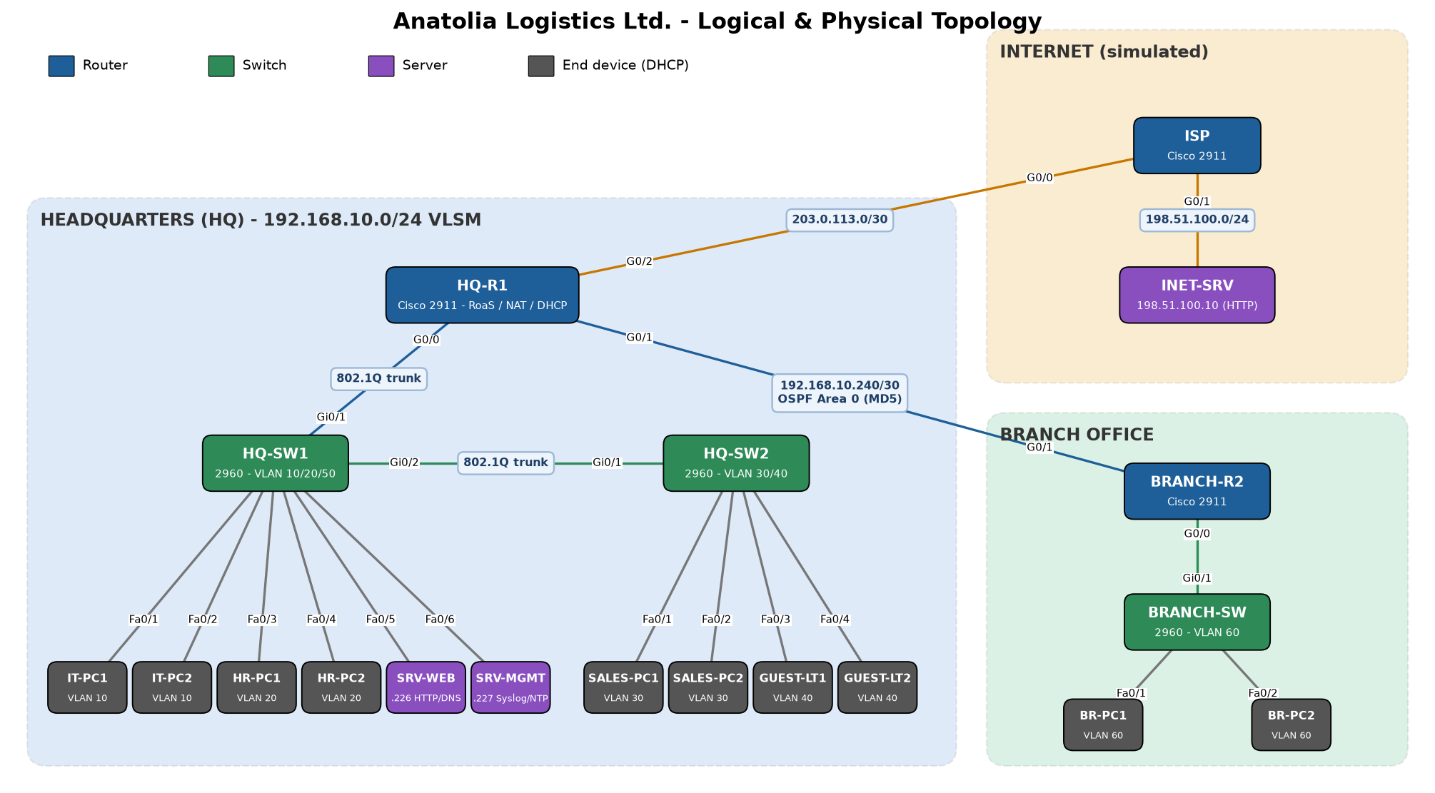
HQ, Branch and a simulated ISP
02 · TOPOLOGY
3 × Cisco 2911 · 3 × Cisco 2960
3 servers · 12 end devices
3 / 14
Notes:
This is our topology. HQ-R1 is the central router. It routes between the five HQ VLANs using router-on-a-stick over one 802.1Q trunk, it connects to the Branch router over a /30 link running OSPF, and it connects to the ISP, where it performs PAT. HQ-SW1 serves IT, HR and the servers; HQ-SW2 serves Sales and Guests. The Branch has its own router, switch and two PCs. We use 2911 routers and 2960 switches, which are standard Packet Tracer devices.

Slide 4
Seven subnets from 192.168.10.0/24
03 · ADDRESSING PLAN
Segment | Hosts | Network | Gateway | Broadcast
Guest · VLAN 40 | 50 | 192.168.10.0/26 | .1 | .63
Sales · VLAN 30 | 40 | 192.168.10.64/26 | .65 | .127
IT / Mgmt · VLAN 10 | 25 | 192.168.10.128/27 | .129 | .159
HR · VLAN 20 | 20 | 192.168.10.160/27 | .161 | .191
Branch · VLAN 60 | 18 | 192.168.10.192/27 | .193 | .223
Servers · VLAN 50 | 8 | 192.168.10.224/28 | .225 | .239
HQ–Branch WAN | 2 | 192.168.10.240/30 | .241 / .242 | .243
4 / 14 · Spare: 192.168.10.244/30 and 192.168.10.248/29
Notes:
Here is the final addressing plan. Seven segments share one /24. The two largest segments, Guest and Sales, get /26 subnets with 62 usable hosts. IT, HR and the Branch get /27s with 30 hosts, the servers get a /28 and the WAN link a /30 with exactly two usable addresses. Gateways are always the first usable address. Twelve addresses remain free for future growth.

Slide 5

Largest first, smallest block that fits
03 · HOW VLSM WORKS
Need
Host bits
Prefix
Block of 64
50 hosts
2⁶ − 2 = 62
/26
.0 – .63
Guest VLAN
2⁵ − 2 = 30 is too small
255.255.255.192
Next subnet starts at .64
244 / 256
With fixed /27 subnets the 50-host Guest VLAN would not fit, and the WAN link would waste 28 addresses.
addresses allocated · 95% used
5 / 14
Notes:
This is how we calculated every subnet. We sorted the segments from largest to smallest. For each one we found the smallest number of host bits where two to the power h minus two is at least the host count. For Guest, 50 hosts: five bits give only 30, six bits give 62, so the prefix is 32 minus 6, which is /26, with a block size of 64. Guest takes .0 to .63 and the next subnet starts at .64. In total we allocate 244 of 256 addresses. Fixed-length subnetting could not do this: a /27 is too small for Guest, and a /27 for the WAN link would waste 28 addresses.

Slide 6
Core services that keep it running
04 · CONFIGURATION
Router-on-a-stick
DHCP
OSPF area 0
One trunk, five 802.1Q sub-interfaces on HQ-R1
Router pools per VLAN, static ranges excluded
HQ ↔ Branch, default route sent to Branch
NAT / PAT
DNS + Web
Management
All hosts share 203.0.113.2 to the Internet
intranet.anatolia.local on SRV-WEB
Syslog, NTP and TFTP backups on SRV-MGMT
6 / 14 · Blue: routing services · Orange: server services
Notes:
These are the core services. HQ-R1 does inter-VLAN routing with one sub-interface per VLAN on a single trunk. It is also the DHCP server for all HQ VLANs; the Branch router serves its own LAN. OSPF connects the two sites, with passive interfaces on the LANs, and HQ-R1 sends a default route to the Branch. All internal hosts reach the Internet through PAT using one public address. On the server side, SRV-WEB provides DNS and the intranet page, and SRV-MGMT collects Syslog messages, gives NTP time to the routers and stores configuration backups over TFTP.

Slide 7
Five layers of defense, each one stopping a different attack.
05 · SECURITY
Device
Switch port
VLAN / STP
Routing
Traffic (ACL)
Notes:
Security was the main focus of the project. We used a defense-in-depth approach with five layers: the devices themselves, the switch ports, VLANs and spanning tree, the routing protocol, and traffic filtering with ACLs. Each layer stops a different kind of attack, so if one control fails, another one still protects the network.

Slide 8
Every threat matched to a control
05 · SECURITY CONTROLS
Layer | Threat | Control
Device | Password guessing, sniffing | enable secret, login block-for, SSH v2 only
Device | Unauthorized management | VTY access-class: only VLAN 10 (IT)
Switch port | Rogue device, MAC flooding | Port security: 1 sticky MAC, shutdown
Switch port | Rogue DHCP server | DHCP snooping, only uplinks trusted
VLAN / STP | VLAN hopping, STP attacks | Native VLAN 999, DTP off, BPDU Guard, unused ports shut
Routing | Fake OSPF neighbors | OSPF MD5 authentication, passive LANs
Traffic | Guests and others reaching data | GUEST-IN and HR-PROTECT extended ACLs
8 / 14
Notes:
This table matches each threat to the control we used. On the devices: hashed passwords, a login block after three failed attempts, and SSH version 2 only, allowed only from the IT VLAN. On switch ports: port security with one sticky MAC address, and DHCP snooping against rogue DHCP servers. For VLANs and spanning tree: an unused native VLAN, DTP disabled, BPDU Guard, and all unused ports shut down in a black-hole VLAN. OSPF uses MD5 authentication. Finally, two extended ACLs filter traffic, which we show on the next slide.

Slide 9
Two ACLs, placed for different reasons
05 · ACCESS CONTROL LISTS
GUEST-IN
inbound · G0/0.40
HR-PROTECT
outbound · G0/0.20
Near the source: guest packets are dropped before they cross the router.
Near the destination: one list guards HR from Sales, Guest and Branch.
permit DHCP requests
permit IT VLAN → HR
permit DNS → SRV-WEB
permit Servers → HR
permit ping → own gateway
permit tcp established
deny → 192.168.10.0/24
permit icmp echo-reply
permit → Internet
deny everything else
9 / 14 · Full ACL syntax: report section 7.6
Notes:
We wrote two extended ACLs. GUEST-IN is applied inbound on the guest sub-interface, close to the source, which is the usual rule for extended ACLs. Guests can get an address, use our DNS server and ping their gateway, but everything to the internal network is denied; everything else, meaning the Internet, is allowed. HR-PROTECT is different: it protects a destination from many sources, so we applied it outbound on the HR sub-interface. Only IT and the servers can start connections to HR. The established and echo-reply lines are important: without them HR users could not get replies for the traffic they start themselves.

Slide 10
The policy holds: allowed and blocked flows
06 · TESTING
Source | Test | Result | Why
IT-PC1 | ping HR-PC1 | Allowed | IT permitted by HR-PROTECT
SALES-PC1 | ping HR-PC1 | Blocked | HR-PROTECT deny
BR-PC1 | intranet.anatolia.local | Allowed | OSPF + DNS + HTTP
GUEST-LT1 | www.internet.com | Allowed | DNS permit + PAT
GUEST-LT1 | intranet.anatolia.local | Blocked | GUEST-IN deny
IT-PC1 | ssh netadmin@HQ-R1 | Allowed | VTY ACL permits VLAN 10
SALES-PC1 | ssh netadmin@HQ-R1 | Blocked | VTY ACL, refused
IT-PC1 | telnet HQ-R1 | Blocked | SSH-only VTY lines
10 / 14 · 8 of 16 tests shown; full matrix in report Table 10
Notes:
We tested sixteen flows; here are eight of them. The important point is that the blocked results are just as expected as the allowed ones. IT can reach HR but Sales cannot. The Branch can open the intranet through OSPF. Guests can browse the Internet but not the intranet. And only IT can manage the router, only with SSH. If there is time, we will show the Sales to HR ping live in the demo.

Slide 11



We attacked our own network
06 · ATTACK TESTS
Rogue device
Rogue DHCP
Brute force
A new laptop replaced IT-PC2 on Fa0/2.
A fake DHCP server in the Guest VLAN offered gateway .50.
Three wrong SSH passwords within 60 seconds.
Result: port err-disabled, PSECURE_VIOLATION logged.
Result: offers dropped; clients still got gateway .1.
Result: router refused all logins for 120 seconds.
11 / 14
Notes:
Then we tried to attack our own network. First, we replaced a PC with an unknown laptop: the port went into err-disabled state immediately and a port-security violation was logged. Second, we connected a fake DHCP server in the guest area that offered a wrong gateway. Because only the uplink ports are trusted, the switch dropped its offers, and the clients still received the correct gateway from HQ-R1. Third, we tried to guess the SSH password: after three failures the router blocked all logins for 120 seconds.

Slide 12
What Simulation mode showed us
06 · TRAFFIC ANALYSIS
DHCP
Discover → Offer → Request → Ack, inspected by DHCP snooping
802.1Q
Frame enters the trunk tagged 30, returns tagged 10
NAT
Source 192.168.10.x becomes 203.0.113.2 with a new port
ACL drop
Sales → HR packet dropped on G0/0.20, ICMP unreachable returned
OSPF
Hellos only on the WAN link, carrying MD5 authentication
12 / 14
Notes:
In Simulation mode we followed packets step by step. We saw the four DHCP messages and the switches inspecting them. We saw router-on-a-stick in action: a frame from Sales enters the trunk with VLAN tag 30 and comes back down the same trunk with tag 10. At HQ-R1 the PDU details show NAT changing the private source address to 203.0.113.2. A ping from Sales to HR is dropped on the HR sub-interface by the ACL. And OSPF hellos appear only on the WAN link, because LAN interfaces are passive, and they carry MD5 authentication.

Slide 13
Four problems we had to solve
07 · CHALLENGES
PCs lost DHCP after snooping
HR could not browse
Fix: no ip dhcp snooping information option, trusted uplinks
Fix: permit established and echo-reply in HR-PROTECT
Guests could not resolve names
Replaced PC disabled the port
Fix: DNS permit placed above the deny line (ACL order)
Fix: documented recovery: clear sticky MAC, shutdown / no shutdown
13 / 14
Notes:
We also ran into problems. After we enabled DHCP snooping, the PCs stopped getting addresses, because the switch added option 82 to the requests; disabling that option and trusting the uplinks fixed it. Our first HR ACL blocked the replies to HR’s own traffic, so we added the established and echo-reply lines. The guest ACL first blocked DNS too; because ACLs are read from top to bottom, we moved a DNS permit above the deny. And when a PC was replaced, port security disabled the port, so we wrote a recovery procedure.

Slide 14
A segmented, managed and layered-secure network on one /24
08 · CONCLUSION
We delivered
Next steps
7 VLSM subnets · 6 VLANs · OSPF + PAT
Central DHCP, Syslog, NTP, TFTP
13 security controls, 16 tests, 3 attack tests
HSRP and a backup WAN link
Cisco ASA firewall, RADIUS / TACACS+
WPA2-Enterprise Wi-Fi, IPv6 dual stack
Live demo & questions
Notes:
To conclude: with one /24 block we built a segmented network with seven right-sized subnets, full connectivity through OSPF and PAT, centralized management, and thirteen security controls verified by sixteen tests and three attack tests. As next steps, the network could get gateway redundancy with HSRP and a backup WAN link, a dedicated ASA firewall, central authentication with RADIUS or TACACS+, a secure wireless network for guests, and IPv6. Now we would like to show a short live demo: a blocked ping from Sales to HR and a port-security violation. Thank you, and we are happy to answer your questions.

